Slide 1
Designing Work Organization
Session 3-4
Prof. Parijat Lanke

Slide 2
Design Choices
Differentiation & Integration
Centralization & Decentralization
S.O.P. & Mutual Adjustment

Slide 3
Differentiation
Vertical Differentiation
Horizontal Differentiation
Is one better than other?
Problem with Differentiation?

Slide 4
Integration Mechanisms
Hierarchy of Authority
Direct Contact
Liaison Role
Task Force
Team
Integrating Role
Integrating Department

Slide 5
Centralization vs. Decentralization
Who gets to make decisions?

Slide 6
Mechanistic -------------- Organic

Slide 7
Structure Types
Organization/management centric
Crowd centric
Employee centric (https://www.youtube.com/watch?v=tJxfJGo-vkI)

Slide 8
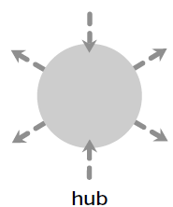
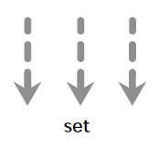
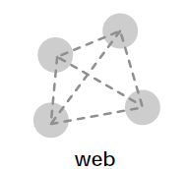
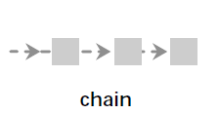
Organigraph

Slide 9
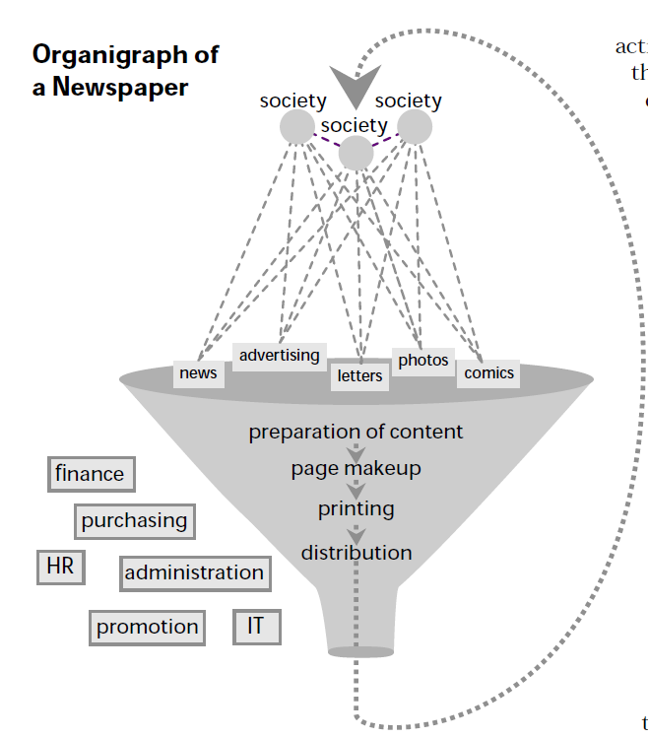

Slide 10
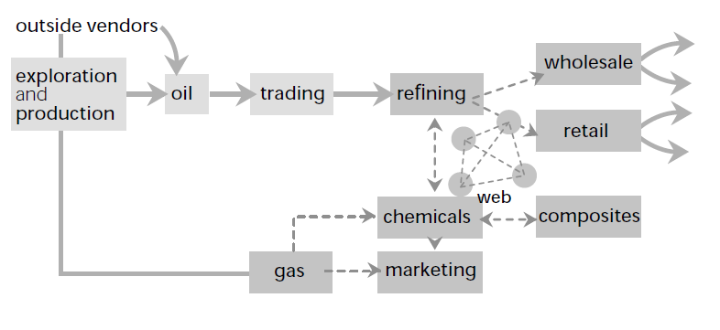

Slide 11

THANK YOU

